Slide 1


Bài tập rèn luyện JSon-Tỉ giá hối đoái DongA Bank

Slide 2
Xử lý JSon trong Kotlin
Vào link này để xem Webservice API cung Tỉ giá hối đoái của DongA Bank: http://dongabank.com.vn/exchange/export
({“items”:[{“type”:”CAD”,”imageurl”:”http:\/\/www.dongabank.com.vn\/images\/flag\/CAD.gif”,”muatienmat”:”16720″,”muack”:”16740″,”bantienmat”:”16930″,”banck”:”16930″},{“type”:”XAU”,”imageurl”:”http:\/\/www.dongabank.com.vn\/images\/flag\/XAU.gif”,”muatienmat”:”3632000″,”muack”:”3621000″,”bantienmat”:”3655000″,”banck”:”3621000″},{“type”:”AUD”,”imageurl”:”http:\/\/www.dongabank.com.vn\/images\/flag\/AUD.gif”,”muatienmat”:”16790″,”muack”:”16800″,”bantienmat”:”16980″,”banck”:”17000″},{“type”:”CHF”,”imageurl”:”http:\/\/www.dongabank.com.vn\/images\/flag\/CHF.gif”,”muatienmat”:”23430″,”muack”:”23450″,”bantienmat”:”23730″,”banck”:”23730″},{“type”:”CNY”,”imageurl”:”http:\/\/www.dongabank.com.vn\/images\/flag\/CNY.gif”,”muatienmat”:”3000″,”muack”:”3000″,”bantienmat”:”3500″,”banck”:”3500″},{“type”:”EUR”,”imageurl”:”http:\/\/www.dongabank.com.vn\/images\/flag\/EUR.gif”,”muatienmat”:”25460″,”muack”:”25480″,”bantienmat”:”25750″,”banck”:”25750″},{“type”:”GBP”,”imageurl”:”http:\/\/www.dongabank.com.vn\/images\/flag\/GBP.gif”,”muatienmat”:”29070″,”muack”:”29110″,”bantienmat”:”29450″,”banck”:”29450″},{“type”:”HKD”,”imageurl”:”http:\/\/www.dongabank.com.vn\/images\/flag\/HKD.gif”,”muatienmat”:”2550″,”muack”:”2900″,”bantienmat”:”2940″,”banck”:”2940″},{“type”:”JPY”,”imageurl”:”http:\/\/www.dongabank.com.vn\/images\/flag\/JPY.gif”,”muatienmat”:”204.3″,”muack”:”204.6″,”bantienmat”:”206.7″,”banck”:”206.7″},{“type”:”NZD”,”imageurl”:”http:\/\/www.dongabank.com.vn\/images\/flag\/NZD.gif”,”muatienmat”:””,”muack”:”16120″,”bantienmat”:””,”banck”:”16320″},{“type”:”PNJ_DAB”,”imageurl”:”http:\/\/www.dongabank.com.vn\/images\/flag\/PNJ_DAB.gif”,”muatienmat”:”3495000″,”muack”:”3495000″,”bantienmat”:”3545000″,”banck”:”3545000″},{“type”:”SGD”,”imageurl”:”http:\/\/www.dongabank.com.vn\/images\/flag\/SGD.gif”,”muatienmat”:”16320″,”muack”:”16340″,”bantienmat”:”16540″,”banck”:”16540″},{“type”:”THB”,”imageurl”:”http:\/\/www.dongabank.com.vn\/images\/flag\/THB.gif”,”muatienmat”:”595″,”muack”:”625″,”bantienmat”:”655″,”banck”:”655″},{“type”:”USD”,”imageurl”:”http:\/\/www.dongabank.com.vn\/images\/flag\/USD.gif”,”muatienmat”:”22680″,”muack”:”22680″,”bantienmat”:”22750″,”banck”:”22750″}]})

Slide 3
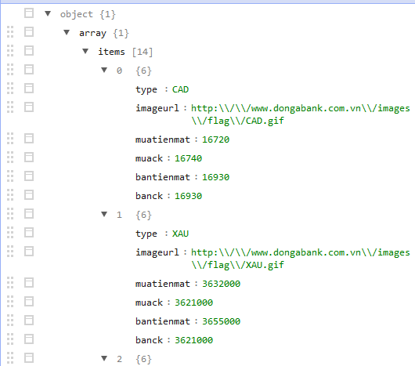
Xử lý JSon trong Kotlin

Slide 4
Xử lý JSon trong Kotlin
class Item { var type:String="" var imageurl:String="" var muatienmat:String="" var muack:String="" var bantienmat:String="" var banck:String="" override fun toString(): String { return "Mã Tiền Tệ : "+type+"\n"+ "Mua tiền mặt :"+muatienmat+"\n"+ "Bán tiền mặt :"+bantienmat+"\n"+ "Mua chuyển khoản :"+muack+"\n"+ "Bán chuyển khoản :"+banck+"\n"+ "Hình đại diện :"+imageurl+"\n" } }

Slide 5
Xử lý JSon trong Kotlin
class TiGia { var items:MutableList<Item> = mutableListOf() }

Slide 6
Xử lý JSon trong Kotlin
fun main(args: Array<String>) { var url:URL=URL("http://dongabank.com.vn/exchange/export") var connection:HttpURLConnection= url.openConnection() as HttpURLConnection var isr:InputStreamReader= InputStreamReader(connection.inputStream,"UTF-8") var br:BufferedReader=BufferedReader(isr) var s= br.readText() br.close() isr.close() s=s.replace("(","") s=s.replace(")","") var gs:Gson= Gson() var dstg:TiGia=gs.fromJson<TiGia>(s,TiGia::class.java) for (item in dstg.items) { println(item) println("-------------------------------") } }

Slide 7


Hey! Coding is easy!
END

